Slide 1
Project: Maven Fuzzy Factory
Sagar Chaglani
Institute of Emerging careers
05/may/2025
After setting up the company’s database system (RDS), my main role has been to analyze and improve it. I focused on understanding the data and providing useful insights to help stakeholders make better decisions and grow the business.
Below are the key findings, actions taken for improvements, and the insights discovered.
Data source:
Maven Analytics
Tools and technologies:
Mysql
Power BI
Skills Enforced:
Sql Joins
Cte’s

Slide 2
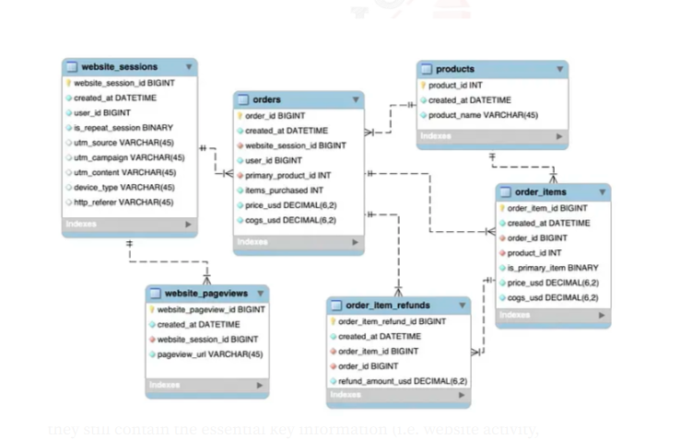
Entity Relationship Diagram (ERD)

Slide 3
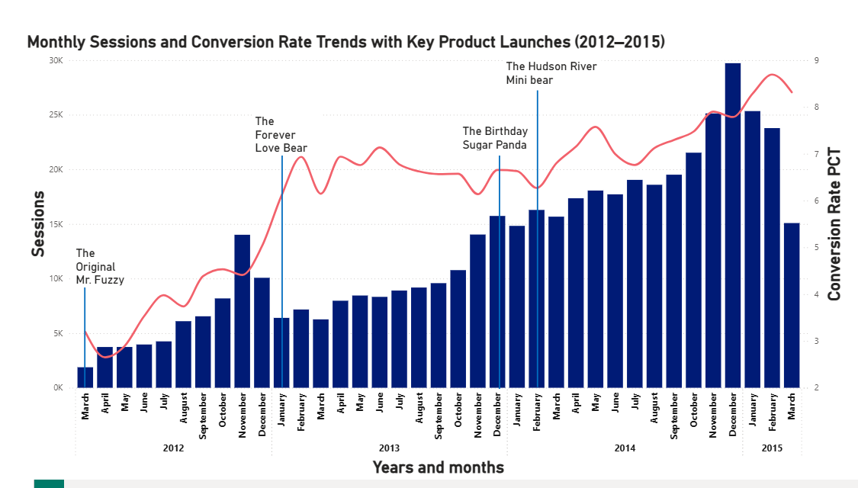
Fuzzy, Healthy Business
The Company Has been steadily growing in past three years with adding more value with each new product launch.
Sessions and orders are increasing in each month and year
Sharp growth in conversion rate from ~3% in 2012 to 8.7% in 2015.

Slide 4
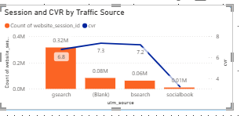
Traffic Source
The bulk of sessions are coming from Gsearch with a conversion rate of 6.8
Socialbook has less conversion rate with low amount of sessions
Bid more on bsearch as the conversion rate is hire here

Slide 5
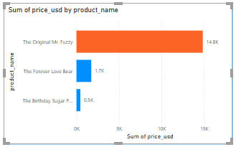
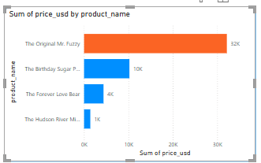
YOY growth of product sales
Mr. Fuzzy has consistently been the best-selling product across all years, with its sales doubling from 2013 to 2014.
Love bear has also increased its sales from 2013 to 2014
2013
2014

Slide 6
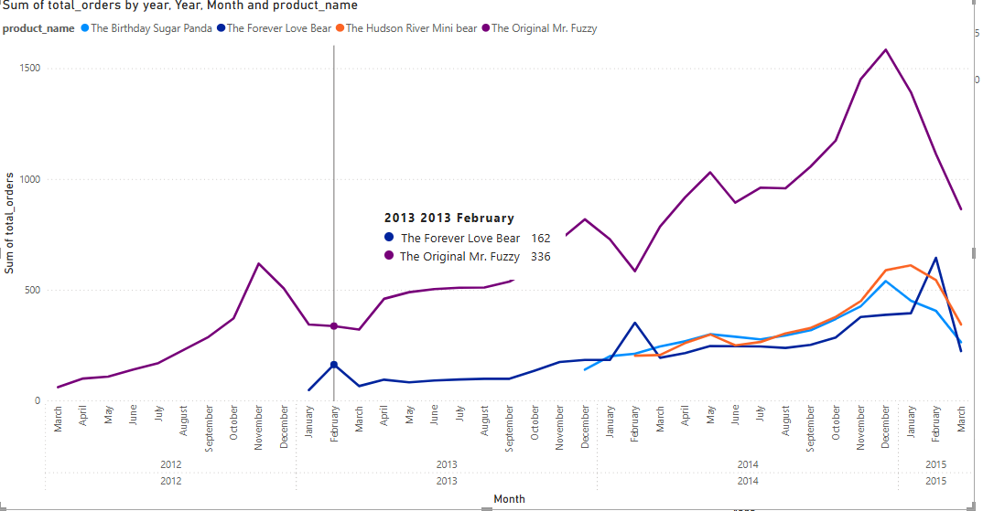
Seasonality trend
Love bear is showing seasonality trend
Valentine's Day

Slide 7
Landing page

Slide 8
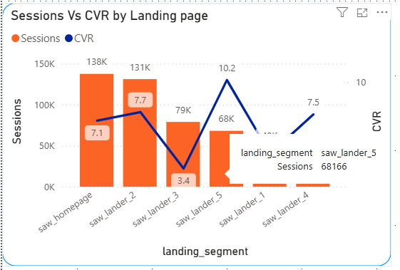
Landing Pages Behavior
Despite having fewer total sessions (68K), saw_lander_5 has the highest conversion rate (10.17%).
This suggests that users coming from lander_5 are highly motivated and likely close to purchase intent.
Saw homepage and saw_lander_2 have the highest traffic (137K+ sessions), but moderate conversion rates (7.06% and 7.72%).

Slide 9
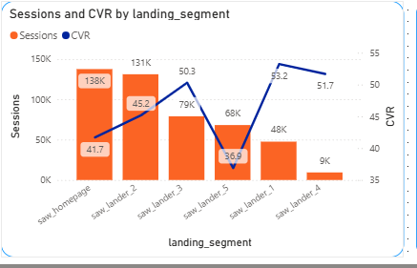
saw_lander_1 and saw_lander_3 have high bounce rates (53.2%, 50.3%) and low conversion rates (4.5%, 3.4%).

Slide 10
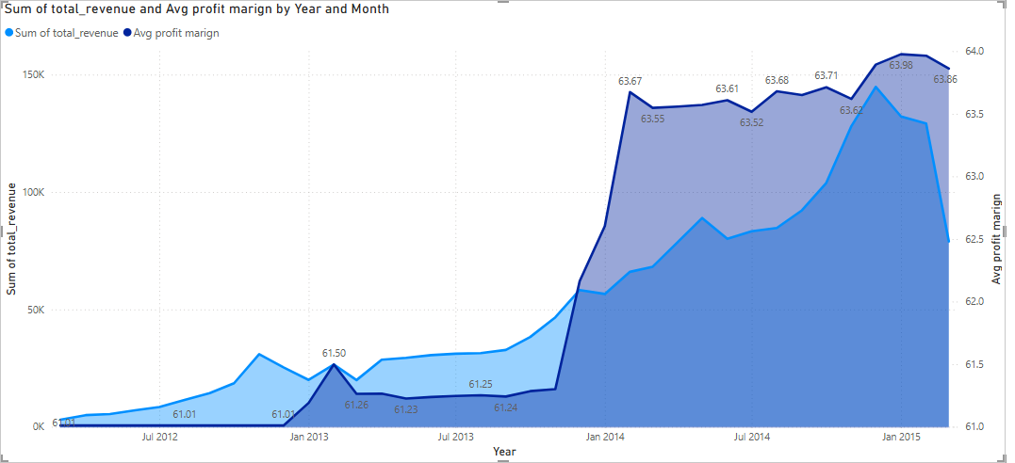
profitability
Revenue is increasing with an avg profit margin of 63% and 64%

Slide 11
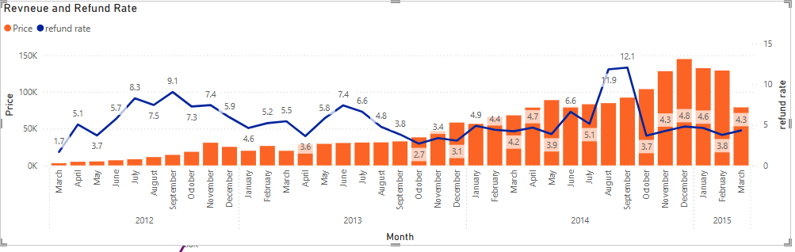
Profitability
Avg refund rate is 5%
Customers are satisfied
reducing it can increase profit margin and decrease customer churns

Slide 12
Insights
Highly profitable business:
Maven fuzzy has high profit margin and each product is adding more value so it is time to launch a new product
Capitalize on Seasonal Demand:
Run targeted marketing campaigns starting mid-January through February 14th.
Ensure inventory levels are sufficient by mid-January.
Offer discounts
campaign
Bid more on bsearch as CVR is higher
Improve quality:
Further reduce the refund rates by taking surveys to know the reason
Improve landing pages
Improve landings pages with high bounce rate and low conversion rate

Slide 13
Thanks

